Slide 1
Definitions
Statistics. The science of collecting, organizing, analyzing, and interpreting data in order to make scientifically based decisions.
Descriptive Statistics. The organizing, summarizing, and displaying of data.
    Inferential Statistics. Using samples to draw conclusions about populations.
Notes:
Descriptive Statistics.
Examples:
Use of charts such as dot plots, scatter plots, bar graphs, etc.
Inferential Statistics.
Examples:
Using probability, hypothesis testing, and model building to make judgments about descriptive data.
Probability -
Hypothesis Testing -
Model Building -

Slide 2
Definitions
Population. The collection of all outcomes, responses, and measurements.
Sample. A subset of a population.
Parameter. A numerical description of a population characteristic.
Statistic. A numerical description of a sample characteristic.
Notes:
Population.
Parameter.
Sample.
Statistic. Statistics are used to measure parameters.
Examples:
Population and Sample. 1000 adults were asked which TV news channel they prefer to view.
The population can be a group consisting of all people who drink soda in America.
Parameter and Statistic. A random sample of recent MBA graduates in the US reported that the median starting salary for MBA graduates is $50,000. In a follow-up study of UW and WSU graduates, it was found that their median starting salaries was about $46,000.

Slide 3
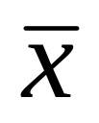


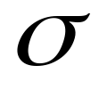


Sample
Population
Statistics
Point Estimates
Parameters
The True Value
mu
Mean
x-bar
sigma
Standard Deviation
Proportion
p-hat

Slide 4
Definitions
Variable – The characteristic that is being measured or observed. The variable will generally be labeled on the X-axis.
Quantitative Variable. Data consisting of pure numerical measurements.
Qualitative Variable. Data consisting of attributes or labels.
Notes:
Qualitative Data.
Examples:
Ford Explorer; Honda Civic.
Red, Green, Yellow.
Heads, Tails
Defective part, Nondefective part.
Quantitative Data.
Examples:
$21,412
402

Slide 5
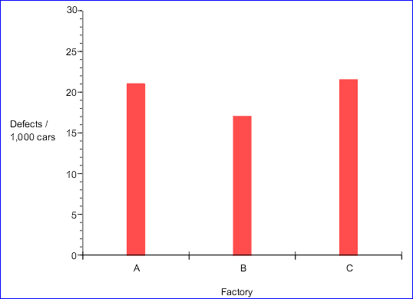
Simple Bar Graph

Slide 6
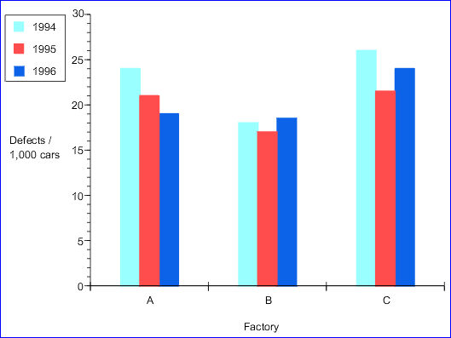
Clustered Bar Graph

Slide 7
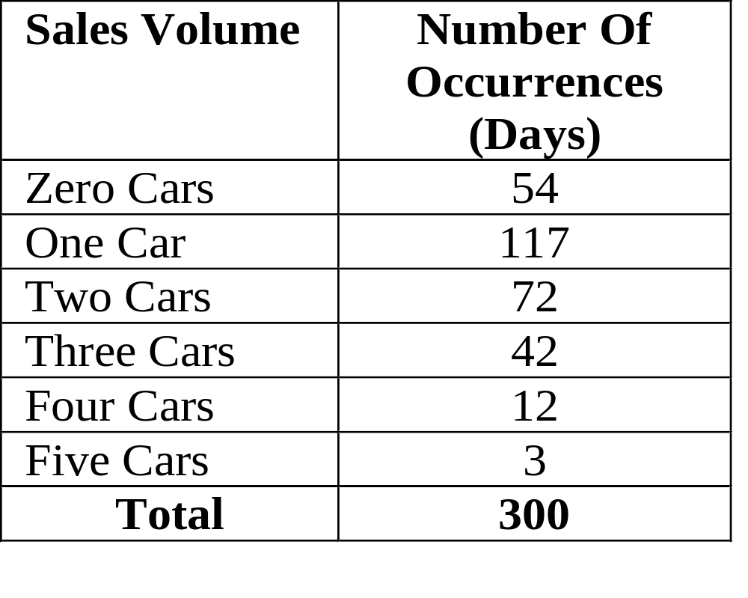
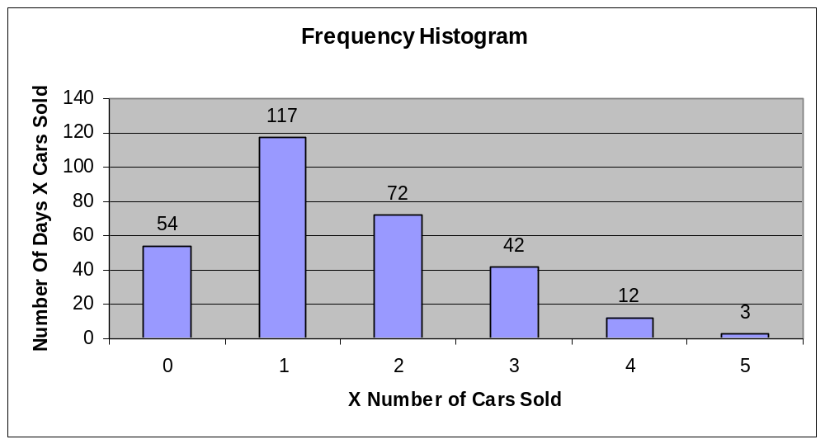

Slide 8
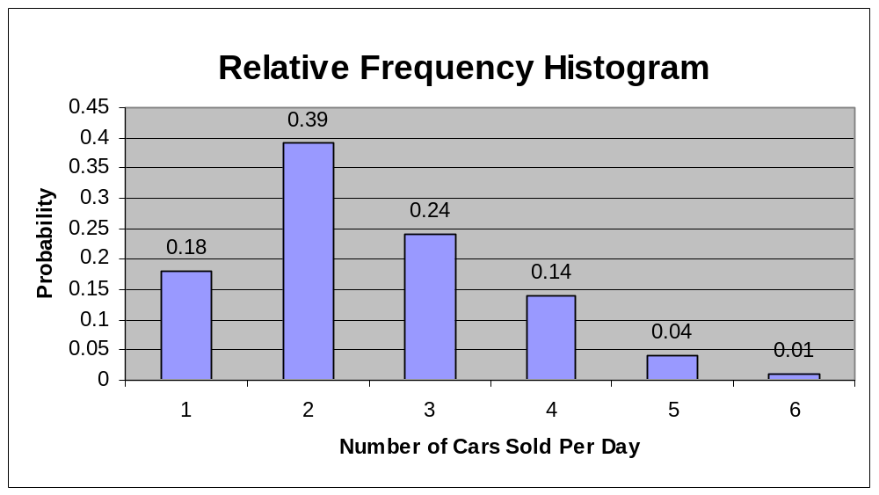
0 1 2 3 4 5

Slide 9
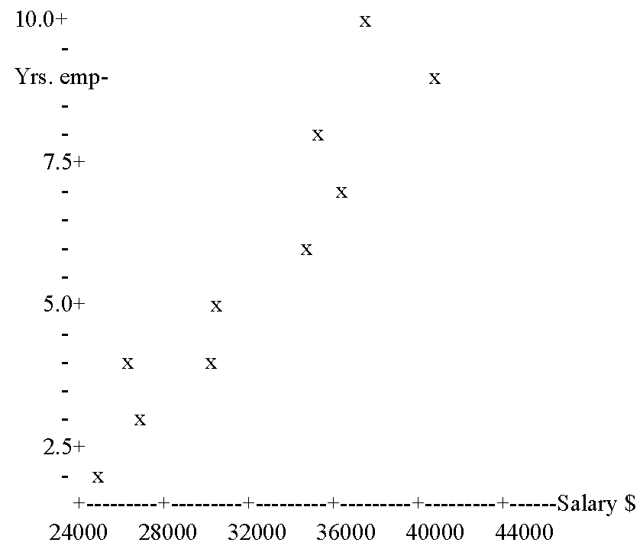
Scatter Plot. A graph that shows paired data, rather than just data in classes like a histogram. The data shows the correlation between two variables.
Notes:
For pairwise data.

Slide 10
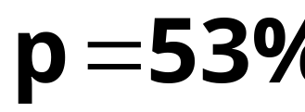




Slide 11
Data Collection
Take A Sampling. Measure part of the population.
Take A Census. Measure the entire population.
Perform Experiments. Induce treatments, observe responses.
Notes:
Example: Who will you vote for?
Take A Census. Provides the most complete information, but is often more costly and difficult to perform. Impossible for this example - too many people, and views change rapidly.
Take A Sampling. More practical and cost effective than taking a census. Randomly select a representative sample from the population (to be discussed).
Simulation. Allows you to evaluate situations that are impractical or dangerous to create in real life. Very cost effective. Example - simulate driving conditions on an intersection. Load driving patterns into computer - speeders, volume during different times of day,
Perform Experiments. Compare treatments with control group. Ex. Cat food - Control group might be the foods she normally eats, while the treatments are a different brand slowly introduced and measured.

Slide 12
Definition of Random
Random Sample - Each element of the population has an equal chance of being selected.
Random.
1. Having a value that can not be determined before the value is taken, but can only be determined probabilistically (such as a random variable).
2. Chosen without regard to any characteristics of the individual members of the population so that each member has an equal chance of being selected.

Slide 13
Sampling Techniques
Stratified Sample. Taking samples from each segment of the population.
Cluster Sample. A sample taken from a population that contains naturally occurring subgroups.
Systematic Sample. Each element is selected at orderly intervals.
Convenience Sample. A sample which consists of only readily available elements.
Notes:
Get Examples:
Stratified Sample. Similar characteristics such as age, gender, ethnicity, political preference, etc. It ensures that each segment of the population is represented.
Cluster Sample. Divide the population into groups (clusters) and then select all the members in in one or more clusters. Ex - different branches of the same bank; geographic cluster like the west end of town. This type of sampling can be very biased, since people on the west side might be totally different than the east side wrt income, etc.
Systematic Sample. Every third, fifth, 100th, etc. member.
Convenience Sample. Ex - going to the beach and asking swimmers how they feel about water quality issues.

Slide 14
Distributions Using a Histogram
Frequency Distribution. A histogram that shows classes (intervals) of data counts.
Relative Frequency Distribution. A histogram that shows the percent of data that falls into classes (intervals).
Cumulative Frequency Distribution (Ogive). A graph that shows the cumulative total of each data count.

Slide 15
Frequency Distribution (table)
Notes:
Patterns are very easy to see.

Slide 17
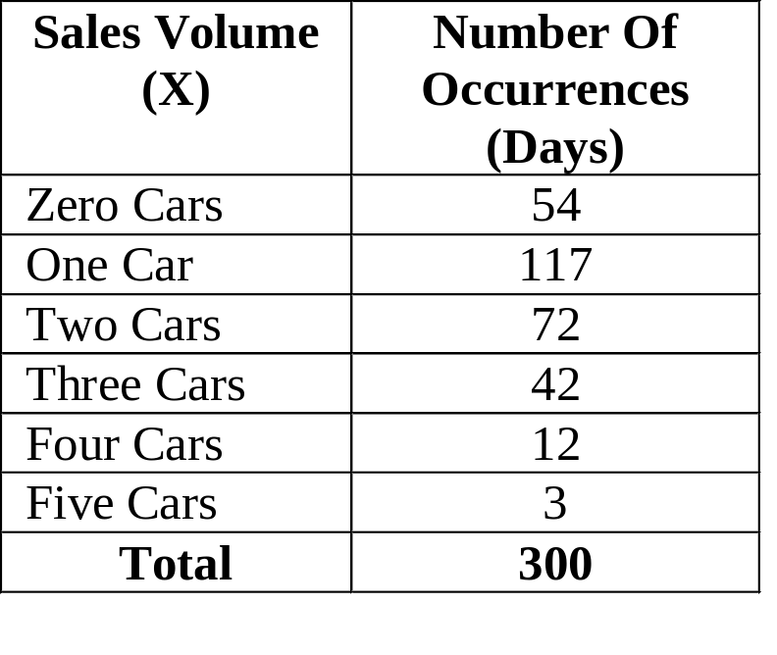
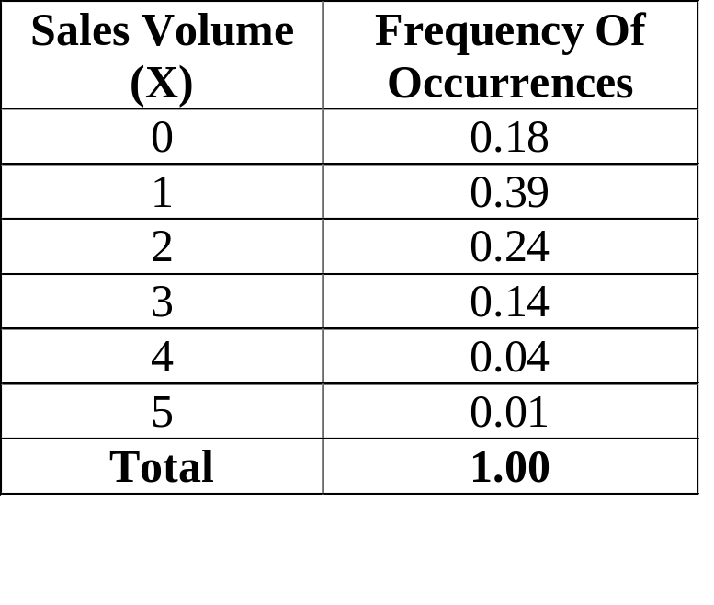
Relative Frequency Table
Notes:
This is the most important chart of all. A histogram with a lot of data will converge to a distribution curve, like the normal distribution.

Slide 18
0 1 2 3 4 5

Slide 19
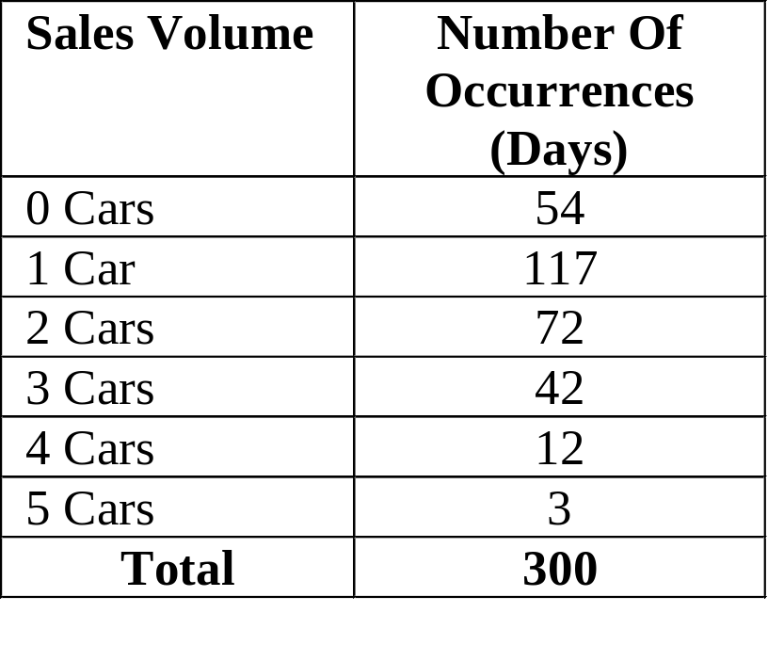
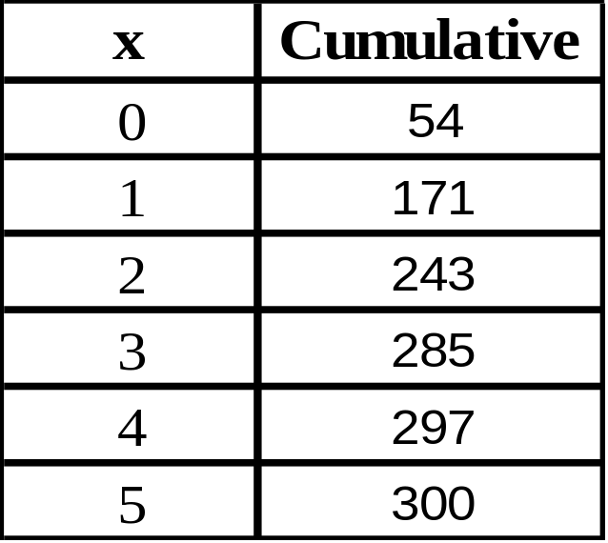
Cumulative Frequency Histograms
Notes:
This is the most important chart of all. A histogram with a lot of data will converge to a distribution curve, like the normal distribution.

Slide 21
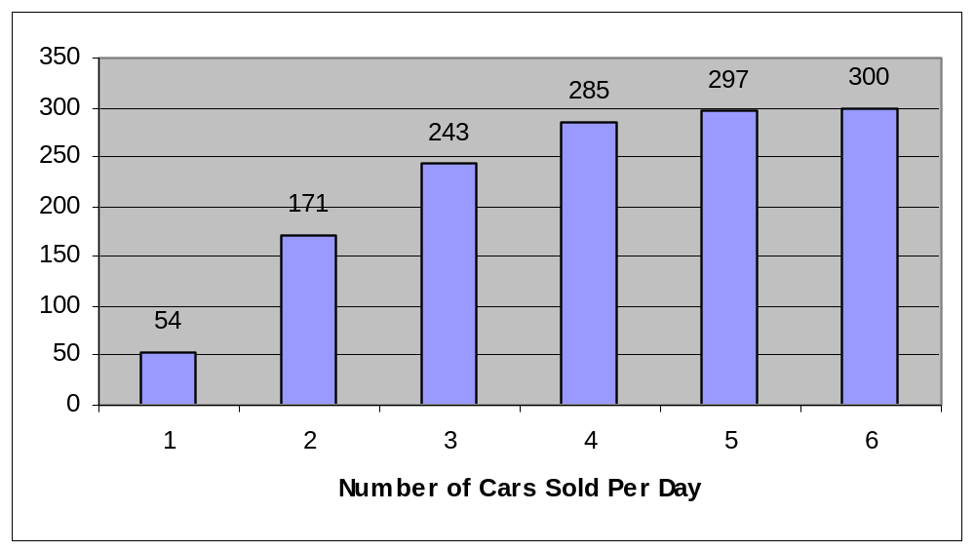
Cumulative Frequency Histogram
0 1 2 3 4 5

Slide 22
Numbers
Real Numbers - Real numbers are made up of the set of all rational and irrational numbers. Real numbers are all of the values on the number line.
Integers - The list of whole numbers and their negative values, which also includes zero. {… -3, -2, -1, 0, 1, 2, 3, …}
Counting Numbers (Natural Numbers) - All positive whole numbers (integers), not including zero. {1, 2, 3, 4, 5, …}.
Discrete vs Continuous – Idea is similar to whole numbers vs real numbers.
See P.11

Slide 23
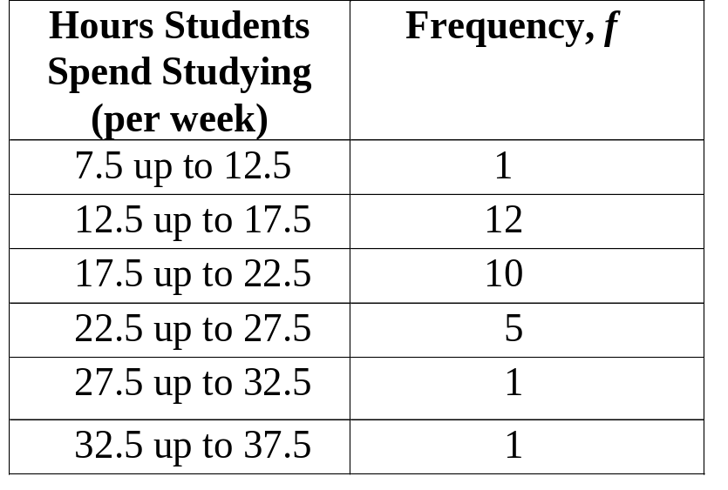
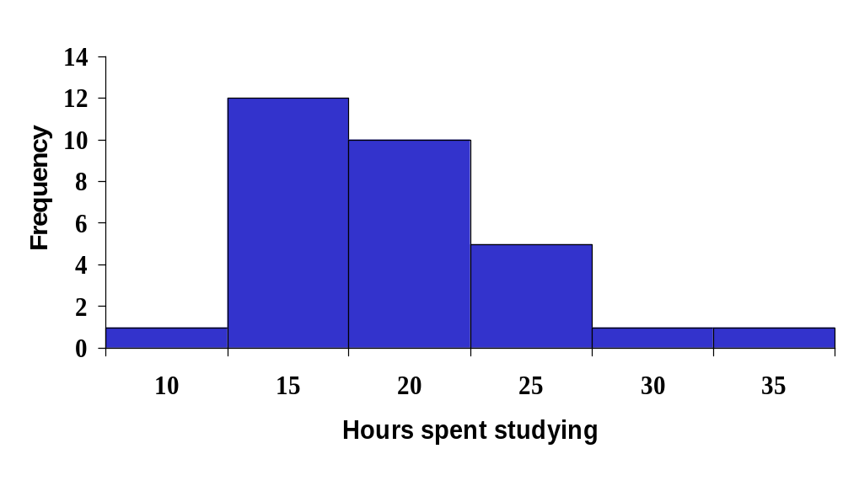
Notes:
There are 30 students total for this example.

Slide 24

Class Frequency: The number of observations in each class.
Class Interval:
The width of the class.
5 units width
Class Midpoint: A point that divides a class into two equal parts. This is the average of the upper and lower class limits.

Slide 25
Notes:
There are 30 students total for this example.

Slide 26
Notes:
There are 30 students total for this example.

Slide 27
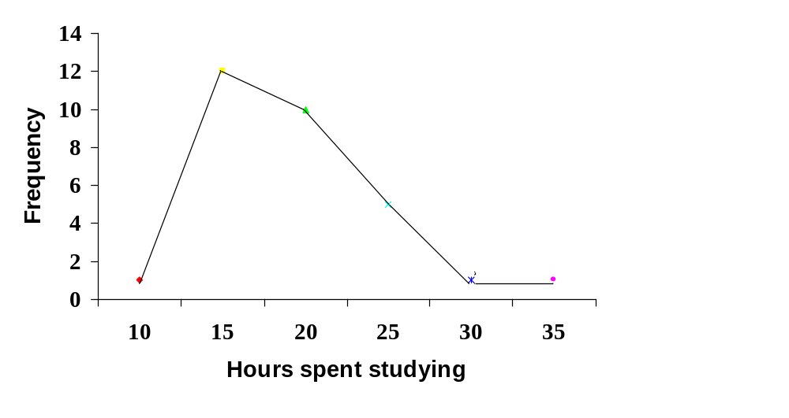
Frequency Polygon for Hours Spent Studying
Notes:
Notice that the line segments connect the class midpoints.

Slide 28
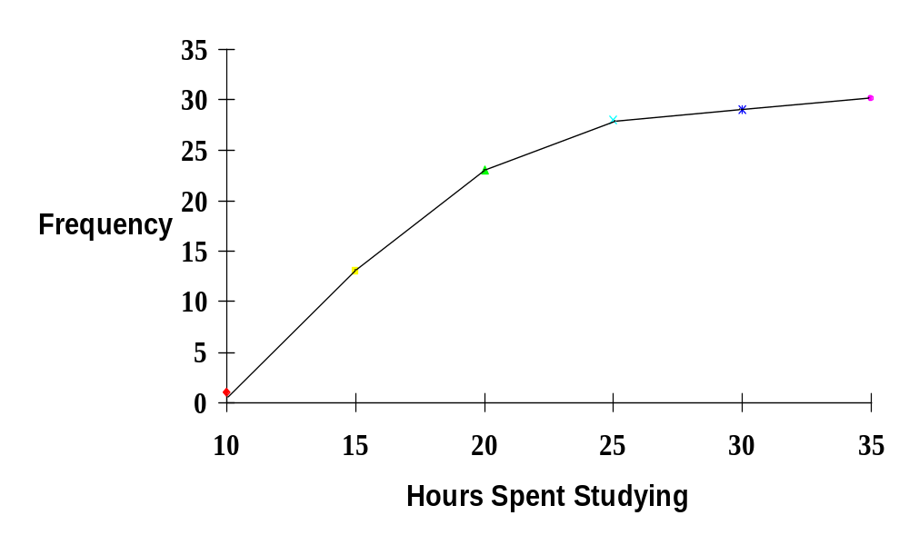
Cumulative Frequency Distribution (Ogive) For Hours Studying

Slide 29
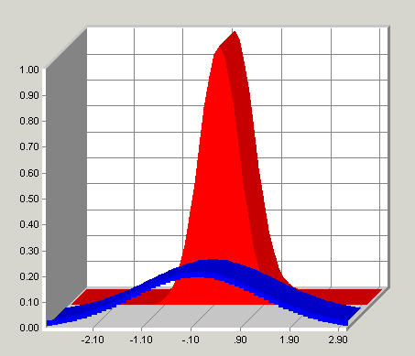
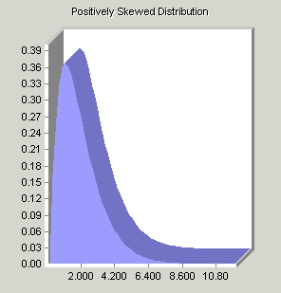
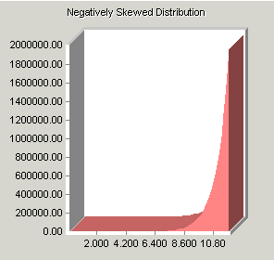
Shapes Of Distributions
A frequency distribution is symmetric when a vertical line can be drawn through the middle of the graph and the resulting halves are approximately mirror images of each other.
A frequency distribution is positively skewed when its tail extends to the right.
A frequency distribution is negatively skewed when its tail extends to the left.
Notes:
A frequency distribution is symmetric when a vertical line can be drawn through the middle of the graph and the resulting halves are approximately mirror images of each other.
A FD is positively skewed when its tail extends to the right.
A FD is negatively skewed when its tail extends to the left.

Slide 30
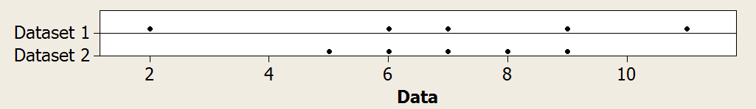
Dotplots
Dataset 1 2 6 7 9 11
Dataset 2 5 6 7 8 9

